Slide 1

Algorithms & Data Structures: A Foundation for Problem Solving
This presentation explores the fundamental concepts. It covers algorithms and data structures. These are essential for efficient problem-solving. We will look at real-world applications and analysis.

Slide 2
Why Algorithms & Data Structures Matter: Real-World Applications
Efficient Problem Solving
Software Development
Data Management
Algorithms and data structures provide a systematic approach. They make problem-solving more efficient. This leads to optimized solutions.
They form the backbone of software development. They are essential for building robust applications. These apps can handle large amounts of data.
Essential for organizing and processing data. This enables quick access. It also enables efficient data manipulation.

Slide 3
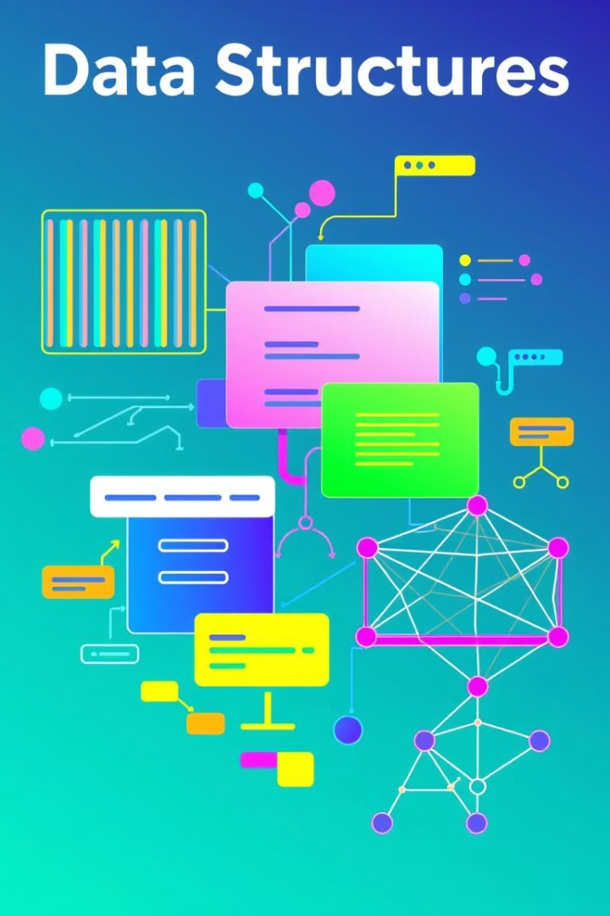
Essential Data Structures: Arrays, Linked Lists, Trees, and Graphs
1
Arrays
Arrays store elements sequentially. They allow quick access using indexes.
2
Linked Lists
Linked lists are a sequence of nodes. Each node points to the next, useful for dynamic data.
3
Trees
Hierarchical structures that efficiently represent relationships.
4
Graphs
Graphs are a set of vertices and edges, representing networks.

Slide 4

Fundamental Algorithms: Sorting, Searching, and Graph Traversal
1
Sorting
Algorithms that arrange elements in a specific order. Common examples include bubble sort and merge sort.
2
Searching
Algorithms used to find specific elements in a dataset. Binary search is one of the fastest.
3
Graph Traversal
Algorithms for visiting all nodes in a graph. This includes breadth-first and depth-first search.

Slide 5




Algorithm Analysis: Understanding Time and Space Complexity
Time Complexity
Space Complexity
Big O Notation
Measures how the runtime of an algorithm grows. It grows as the input size increases.
Space complexity quantifies the amount of memory. The memory amount is used by an algorithm.
Big O notation is a standard way to express complexity. It expresses complexity in the worst-case scenario.

Slide 6
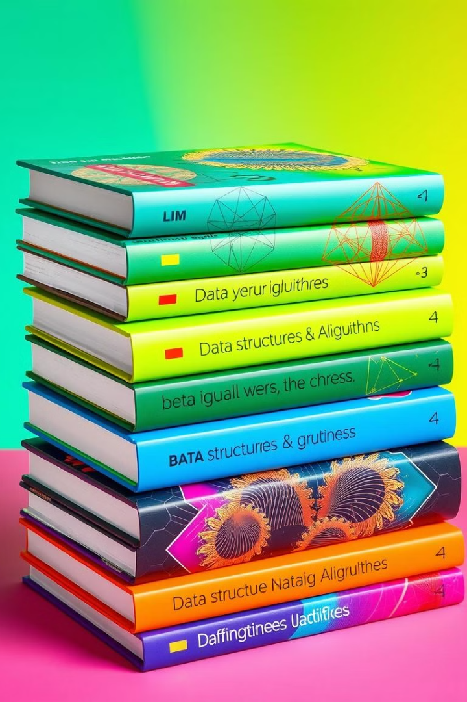
Mastering Algorithms & Data Structures: Resources and Next Steps
Online Courses
Books
Platforms like Coursera and Udemy offer in-depth courses. They cover algorithms and data structures.
Introduction to Algorithms by CLRS is a comprehensive guide. It is for serious learners.
Practice
Websites such as LeetCode and HackerRank provide coding challenges. They sharpen your skills.

